Slide 1
Analysis of the Indian Premier League (IPL)
A guide on what makes a perfect IPL team!
By - Alexei Beuno. H

Slide 2
What is the Indian Premier League ?
The Indian Premier League (IPL) is a 20-20 cricket league managed and organised by the Board of Control for Cricket (BCCI) in 2007.
With billions of views registered every year, every brand wants to encash this opportunity by having a share of the sponsorship and advertising.
IPL's revenue comes from several sources: ticket sales, partnerships and TV commercials. TRP for a single match is ~12.6 million viewers.
A player with the right skill attracts the crowd and hence by endorsing such a player, the companies would be able to successfully market their products to their target audience.
Companies have endorsed almost 70 products through IPL.

Slide 3
How was it done?
Analysed IPL data from 12 seasons to gather insights.
IPL data was recorded at two different levels and stored in the following tables:
Missing values in the Deliveries table can be considered as a category depicting a delivery which did not result in a dismissal.
Deliveries table is not granular enough – depicts only crucial players during each delivery.
# | Table Name | No. of Rows | No. of Columns | Table Description
1. | Matches | 756 | 18 | A high level overview depicting crucial match events such as – toss results, match results, man of the match, and match umpires.
2. | Deliveries | 1,79,078 | 21 | A detailed view granular to each delivery covering events such as – bowlers, batsmen at strikers & non-strikers end, runs per delivery, dismissal reason and players that made a stumping or took a catch.
Seasons | Matches Played | Innings Played | Balls Bowled | Runs Made | Wickets Taken | Run Outs Made | Catches Caught | Stumpings Done
12 | 756 | 1,512 | 179,078 | 2,23,286 | 7,968 | 848 | 5,323 | 277

Slide 4
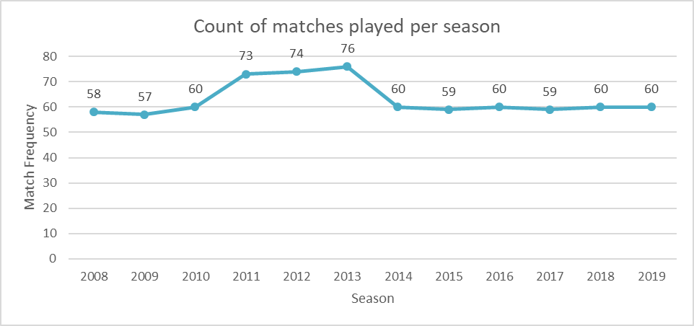
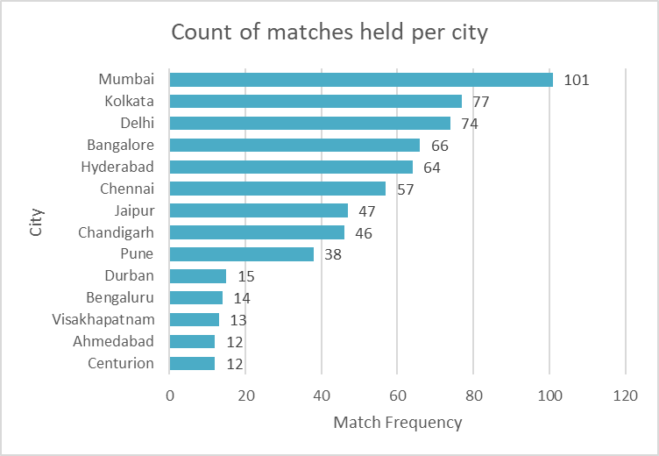
Potential reach of IPL Ad-Campaigns
Each match provides a higher opportunity to advertise, at an average there are 63 matches played in each season.
IPL provides an opportunities to increase brand visibility:
A wide range of matches have been played in metropolitan cities like Mumbai, Kolkata, Delhi and Bangalore, that helps improve the potential reach of these brands.
Insert a line chart:
X-axis = Season
Y-axis=count of matches played on primary axis
Plot a line representing the average no of matches per season.
# | Opportunity Type | Opportunity Mode
1. | Player Jersey's | Online and Offline
2. | TV Sponsorships | Online only
3. | Tickets to matches | Offline only
4. | Stadium Announcements | Offline only
Insert a bar chart:
X-axis = City
Y-axis=count of matches played across all seasons.

Slide 5
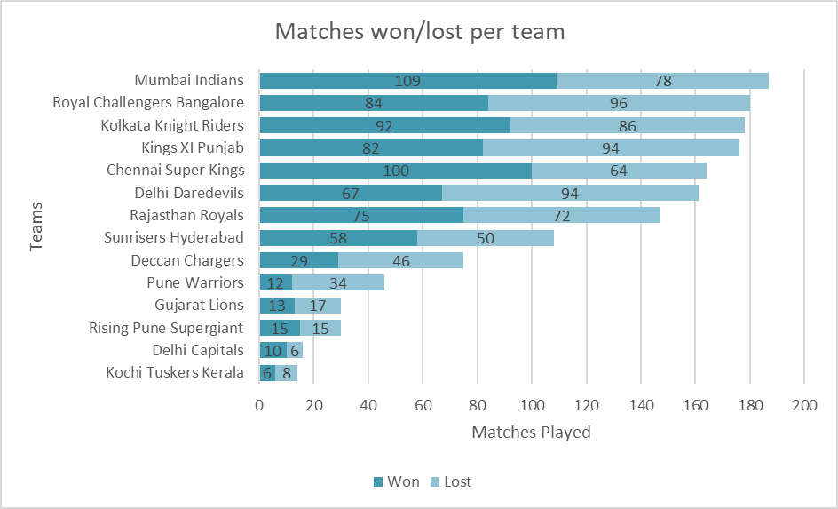
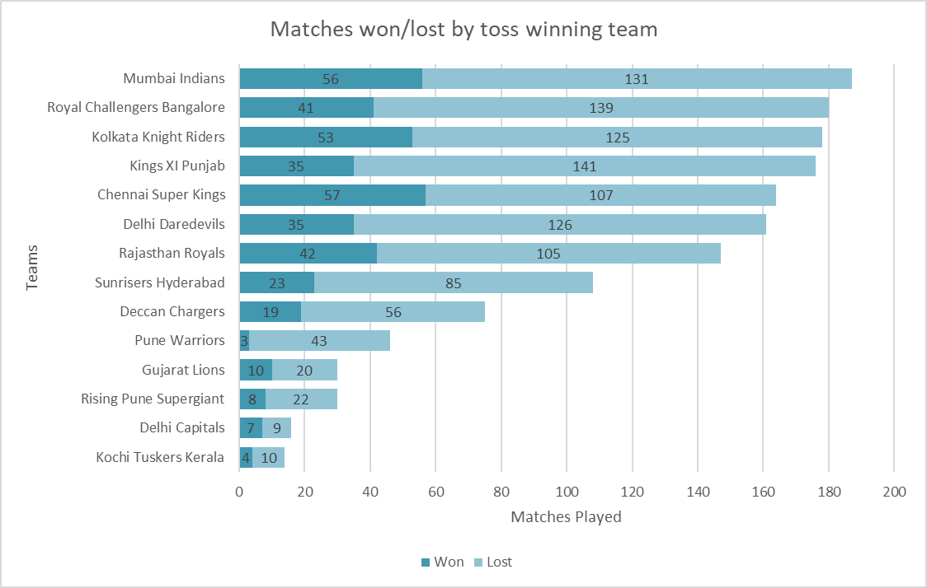
The chosen ones!
Mumbai Indians and Chennai Super Kings have won significant number of matches after winning the toss and hence are the top performing teams
Kolkata Knight Riders, Kings XI Punjab and Rajasthan Royals are one among them as well.
RCB lost most of the matches compared to other teams and therefore might have not won the tournament even though they are one of the highest runs scoring team.
Companies can endorse these teams for ads as they are the top performing teams that have entertained the viewers.
Insert a stacked bar chart:
X-axis = team names
Y-axis=count of matches played
Showing the distribution of matches won vs lost in each bar. Sort the chart in descending order of the total matches played.
Insert a stacked bar chart:
X-axis = team names
Y-axis= count of matches played
Showing the distribution of matches won vs lost in each bar.
Do this only for the teams that won the toss.
Sort the chart in descending order of the total matches played.

Slide 6
Does winning the toss imply winning the match?
Null hypothesis(Ho): Winning the toss does not imply winning the match.
Alternate hypothesis(H1): Winning the toss implies winning the match.
Since p-value is not less than 0.05, null hypothesis is rejected.
Hence, there is a slight edge for teams that win the toss as they are more likely to win the match
Chi Square Value | P-value | Degrees of freedom
154 | 0.25 | 143

Slide 7
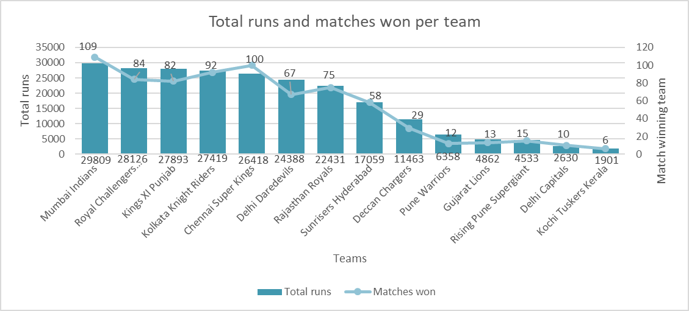
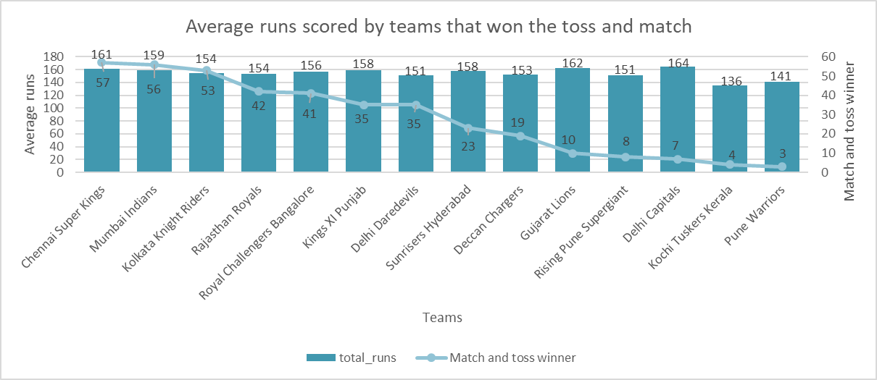
What does runs say about the matches won?
Royal Challenger's Bangalore scored the maximum runs across seasons and yet lost a significant number of matches.
Mumbai Indians and Chennai Super Kings have won most of the matches compared to the total runs scored.
Even though the average runs is in the same range for all the teams, only, MI, CSK and KKR managed to win most number of matches having won the toss
Mumbai Indians and Chennai Super Kings are the successful teams.
Insert a bar chart:
X-axis = team names
Y-axis=Total runs scored from all seasons
Showing the distribution of matches won vs lost in each bar. Sort the chart in descending order of the total matches played.
Insert a stacked bar chart:
X-axis = team names
Y-axis= Average runs scoreShowing the distribution of matches won vs lost in each bar.
Do this only for the teams that won the toss.
Sort the chart in descending order of the total matches played.

Slide 8
Does the team score more runs if they win the toss?
Null hypothesis(Ho): The team does not score more runs if they win the toss
Alternate hypothesis(H1): The team scores more runs if they win the toss.
Since T value is smaller than the t-critical, the null hypothesis is not rejected
This implies that the team does not score more runs if they win the toss.
# | Mean | Variance | Observations | P(T<=t) one tail | tcritical
Total runs | 16806.42 | 120651666.6 | 14 | 3.4996E-05 | 1.7709
Toss winner | 54 | 1231.53 | 14

Slide 9
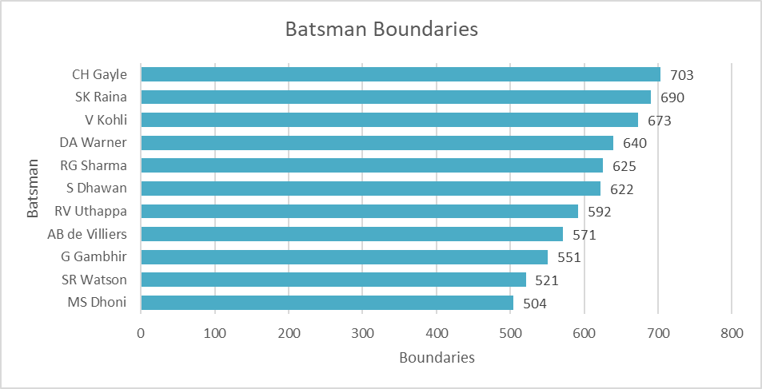
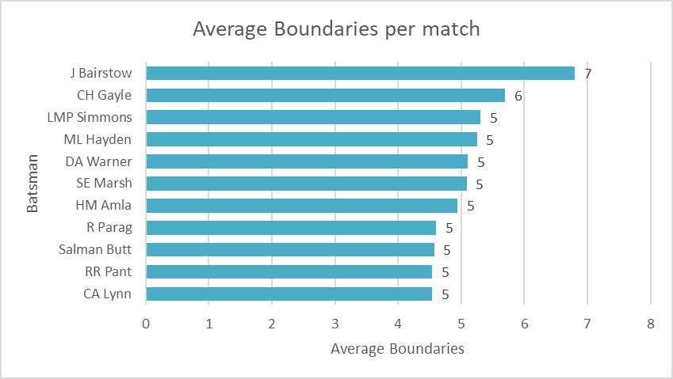
Batsmen with the most Explosion!
These batsman have recorded a total of 500+ boundaries from 2008-2019. Chris Gayle topping the list.
Average boundaries of a top performing batsman is around 5-7 in a match.
Batsman with the most explosion is most likely to grab audiences' attention, they are the latent influencers and hence, the companies can target them for ad campaigns.
Insert a bar chart:
X-axis = Player Name
Y-axis=count of boundaries in all seasons
Insert a bar chart:
X-axis = Player Name
Y-axis=average count of boundries in a match.

Slide 10
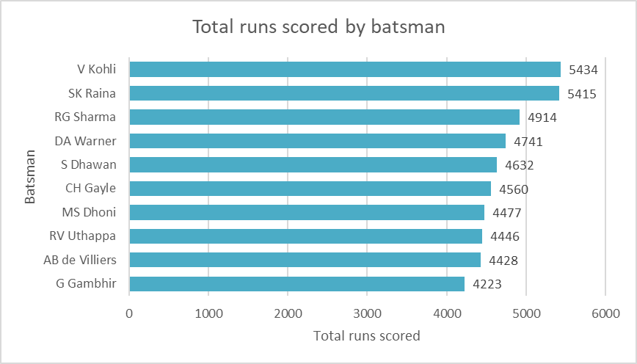
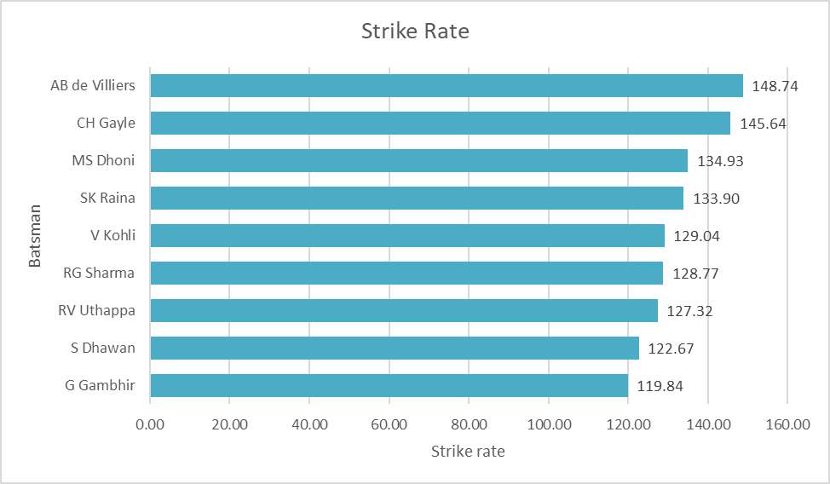
Super Strikers
The batsman with the most runs in the tournament during the season, would wear the Orange cap.
Since Virat Kohli is the highest run scoring machine, he is most likely to wear orange cap the most number of times.
A high strike rate indicates how quickly can a batsman score runs.
These Super Strikers would be ideal for companies to target to get their products sold.
Insert a bar chart:
X-axis = Player Name
Y-axis=count of boundaries in all seasons
Insert a bar chart:
X-axis = Player Name
Y-axis=average count of boundries in a match.

Slide 11
Indian batsmen are the top run-scorers
Almost all the top batsman are from the Indian origin except David Warner from Australia
List of top 5 Batsmen in the IPL:
# | Batsman | Total Balls Faced | Balls at Non-Sticker's End | Total runs scored | Maximum runs in a match | Fours | Sixes | Highest Score per Inning | Centuries | Half Centuries | Run Rate
1. | V Kohli | 4211 | 4071 | 5434 | 113 | 482 | 191 | 2876 | 13 | 482 | 151
2. | SK Raina | 4044 | 4173 | 5415 | 100 | 495 | 195 | 3108 | 1 | 386 | 163
3 | RG Sharma | 3816 | 3858 | 4914 | 109 | 431 | 194 | 2837 | 9 | 351 | 155
4 | DA Warner | 3398 | 3127 | 4741 | 126 | 459 | 181 | 2571 | 26 | 629 | 112
5 | S Dhawan | 3776 | 4090 | 4632 | 98 | 526 | 96 | 2690 | 0 | 364 | 139

Slide 12
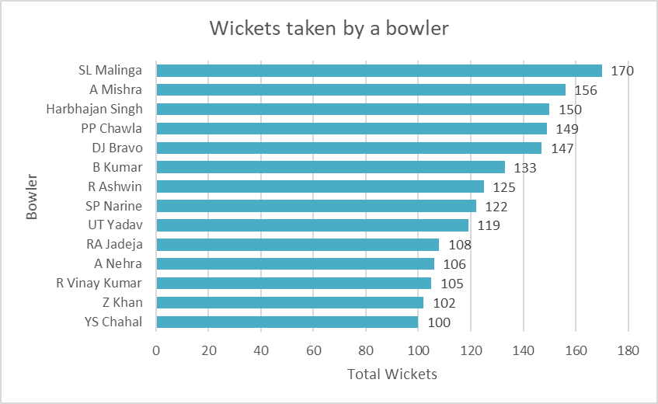
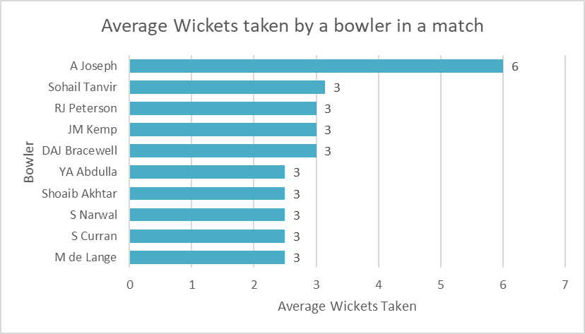
Tidy Bowlers
The bowler who has taken the most wickets in a league is the potential purple cap holder.
The bowlers that have taken 100+ wickets throughout the IPL franchise is shown. SL Malinga being the bowler that has taken the most wickets.
Average wickets taken by eminent bowlers in a match is around 3-6.
These top performing Tidy Bowlers are ideal for companies to endorse them.
Insert a bar chart:
X-axis = Player Name
Y-axis=count of boundaries in all seasons
Insert a bar chart:
X-axis = Player Name
Y-axis=average count of boundries in a match.

Slide 13
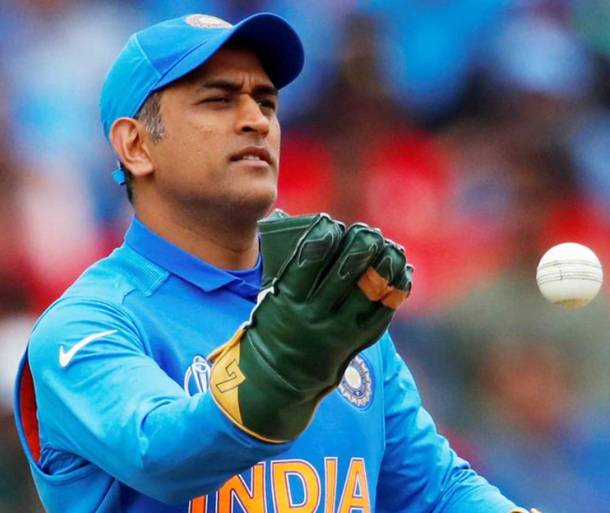
Indians are the top fielders
Almost all the top fielders are from the Indian origin AC Gilchrist from Australia
MS Dhoni is the most efficient fielder having the maximum number of Stumpings and Run Outs.
List of top 5 fielders in the IPL:
# | Fielder | Catches | Stumpings | Run Outs
1. | MS Dhoni | 98 | 38 | 23
2. | RV Uthappa | 84 | 32 | 9
3 | KD Karthik | 109 | 29 | 14
4 | WP Saha | 60 | 18 | 4
5 | AC Gilchrist | 51 | 16 | 8

Slide 14
What teams or players should a company endorse?
Mumbai Indians, Chennai Super Kings, Kolkata Knight Riders and Kings XI Punjab are the top performing teams. Even though Royal Challengers Bangalore did not win significant matches, it has won the hearts of people, making this quality very much essential for ad campaigns.
Most of the top performing batsman are from Indian origin. Chirs Gayle, David Warner and AB de Villiers being the top oversees players.
SL Malinga is the highest wicket taking bowler and A Joseph has taken the highest average wickets in a match making them the best bowlers.
Top performing fielders are also from the Indian Origin. MS Dhoni being the best wicket keeper, has the highest record of Stumpings and Run Outs made.
In conclusion, the companies must target these teams and endorse them for marketing their products.

